Slide 1
Confusion Matrix and ROC Curve
Gordon Gao
Carey Business School Professor

Slide 2
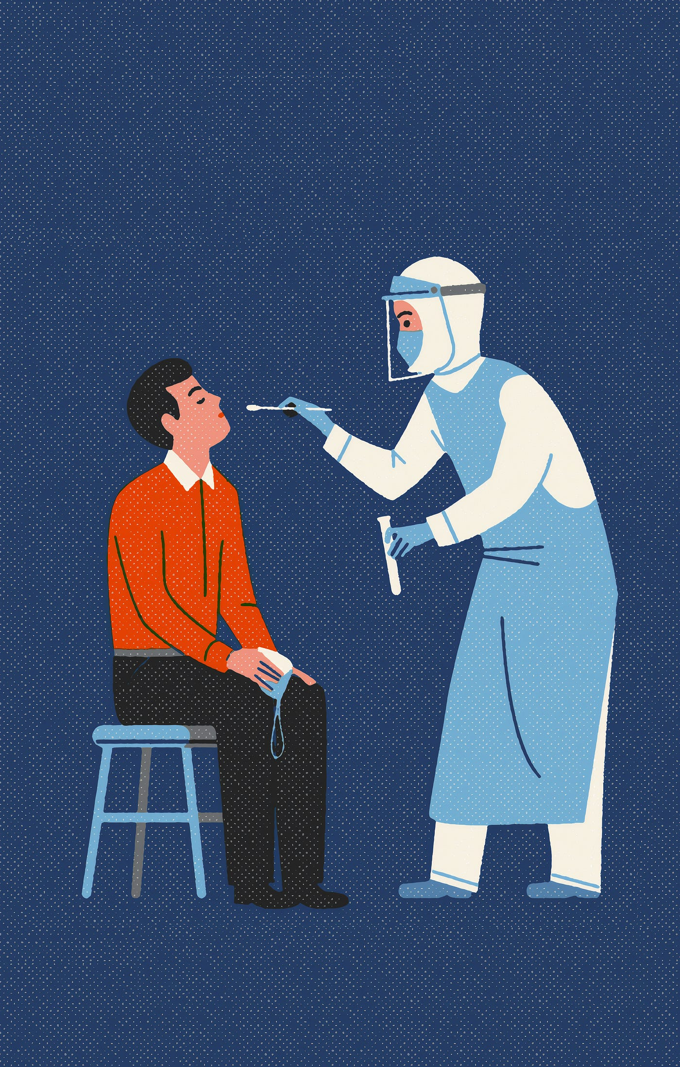
Null hypotheses (H0):
life as usual, not have Covid.
Alternative hypothesis (H1):
new situation, new conditions
new diagnosis

Slide 3
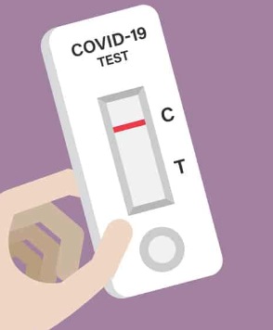


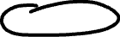
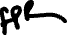
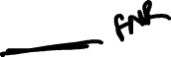

The so-called “Confusion Matrix”
Tested
Negative
Positive
A test result may show you have the condition when you don’t. This is a false-positive result. (Type 1 error)
On the other hand, your test may show that you don’t have the condition when you do. This is a false-negative result.
(Type 2 error)
True Negative
False Positive
No Covid
Actual
(Type 1 error)
False Negative
True Positive
Covid
(Type 2 error)
Notes:
Xx: make the icon smaller

Slide 4

Scenario Overview:
As a cancer screening company, you've developed an AI model to analyze mammography images for early cancer detection. Among 10 customers, 4 of them really have cancer and 6 do not.
You're now at a crucial stage: evaluating the model's performance.
Non-Cancer
Cancer
Non-Cancer
Cancer
Non-Cancer
Cancer
Non-Cancer
Non-Cancer
Cancer
Non-Cancer
Notes:
https://my.clevelandclinic.org/health/diagnostics/24118-cancer-screening

Slide 5
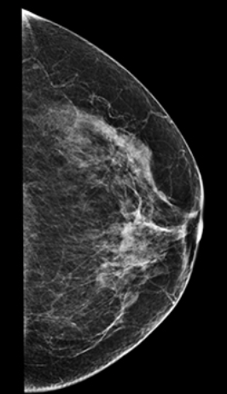


Process of evaluating an ML model
Cancer detected
True Positive
False Negatives
0.5
False Positives
No Cancer detected
Raw Prediction
Score
Between 0 to 1
True Negative
Image input
AI model
Thresholding
Comparison with Ground Truth

Slide 6
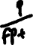

Non-Cancer
Non-Cancer
Non-Cancer
Cancer
Non-Cancer
Non-Cancer
Cancer
Non-Cancer
Cancer
Cancer
N
N
N
N
N
P
P
P
P
P
0.1
0.2
0.3
0.4
0.5
0.6
0.7
0.8
0.9
0.0
Threshold = 0.5
1.0
Predicted Risk of Cancer (in probability)
Metrics to evaluate a classification model's predictions
Precision: What proportion of positive identifications was actually correct?
Recall: What proportion of actual positives was identified correctly?
Accuracy: is the fraction of predictions our model got right
True positive rate (same as recall): What proportion of positive identifications was actually correct
False positive rate: Proportion of positive instances that are inaccurately detected as positive by the model
Precision = 0.8
Recall = 0.8
Accuracy =0.8
TPR = 0.8
FPR = 0.2
Threshold=0.5
Notes:
XX: 4 red, 6 black

Slide 7
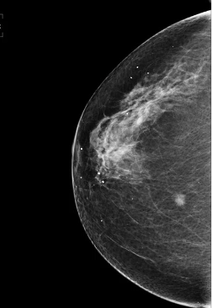
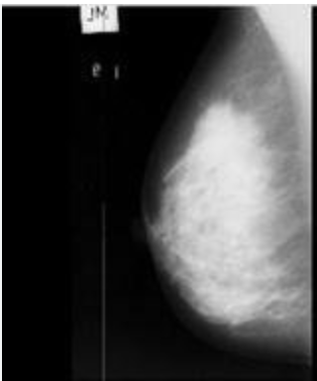
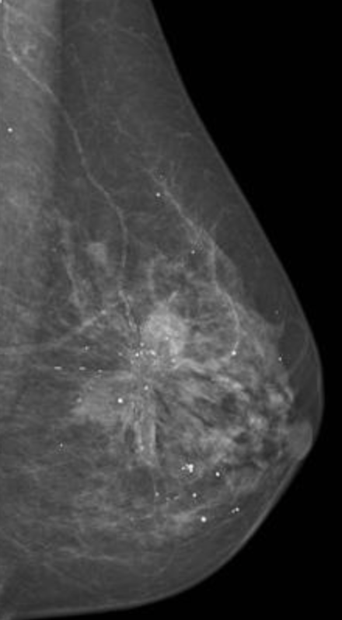
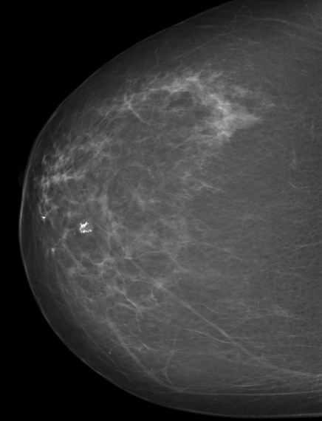
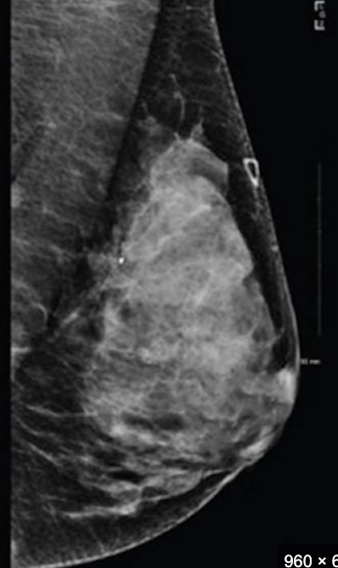
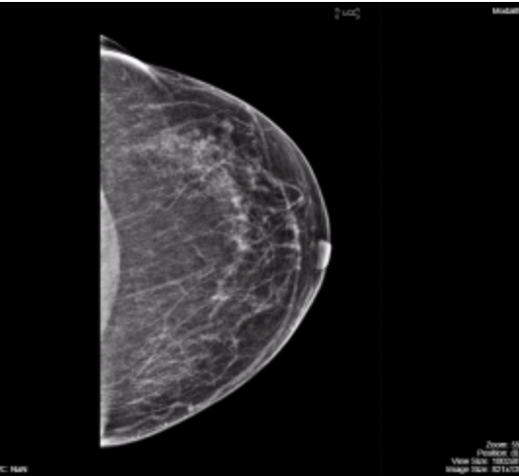
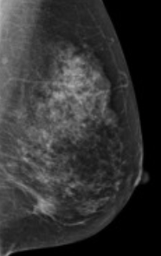
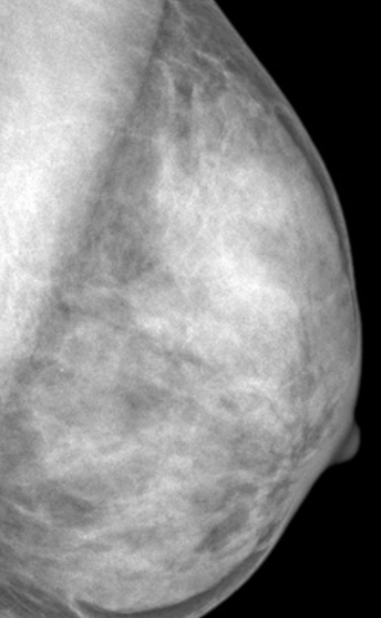
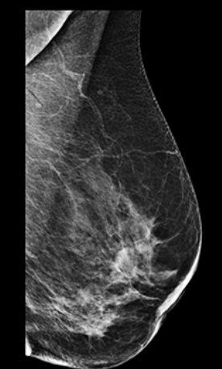
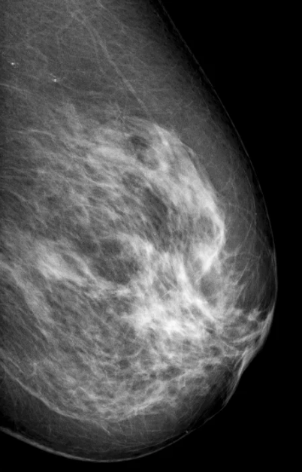
Process 10 images
Prediction score
0.95
0.86
0.75
0.68
0.55
0.48
0.37
0.28
0.15
0.05
Fed these images into our Machine Learning model
Arrange the results in descending order based on the model's prediction scores

Slide 8

Patient | Image | Prediction Score | Threshold | Classification | Ground truth | Comparison with Ground Truth
1 |  | 0.95 | 0.5 | Cancer | Cancer
2 |  | 0.86 | 0.5 | Cancer | Cancer
3 |  | 0.75 | 0.5 | Cancer | Non-Cancer
4 |  | 0.68 | 0.5 | Cancer | Cancer
5 |  | 0.55 | 0.5 | Cancer | Non-Cancer
6 |  | 0.48 | 0.5 | Non-Cancer | Non-Cancer
7 |  | 0.37 | 0.5 | Non-Cancer | Cancer
8 |  | 0.28 | 0.5 | Non-Cancer | Non-Cancer
9 |  | 0.15 | 0.5 | Non-Cancer | Non-Cancer
10 |  | 0.05 | 0.5 | Non-Cancer | Non-Cancer
True Positive
True Positive
False Positives
True Positive
False Positives
True Negative
False Negatives
True Negative
True Negative
True Negative
Non-Cancer
Non-Cancer
Non-Cancer
Cancer
Non-Cancer
Non-Cancer
Cancer
Non-Cancer
Cancer
Cancer
N
N
N
N
N
P
P
P
P
P
0.1
0.2
0.3
0.4
0.5
0.6
0.7
0.8
0.9
0.0
Threshold = 0.5
1.0

Slide 9
TN
TN
TN
FN
TN
FP
TP
FP
TP
TP
Non-Cancer
Non-Cancer
Non-Cancer
Cancer
Non-Cancer
Non-Cancer
Cancer
Non-Cancer
Cancer
Cancer
N
N
N
N
N
P
P
P
P
P
0.1
0.2
0.3
0.4
0.5
0.6
0.7
0.8
0.9
0.0
Threshold = 0.5
1.0
Predicted Risk of Cancer (in probability)
Metrics to evaluate a classification model's predictions
Precision = TP / (TP + FP) = 3 / (3 + 2) = 3/5 = 0.6
Recall (same as TPR) = TP / (TP + FN) = 3 / (3 + 1) = 3/4
Accuracy = (TP + TN) / Total cases = (3 + 4) / 10 = 7/10
Precision: What proportion of positive identifications was actually correct?
Recall: What proportion of actual positives was identified correctly?
Accuracy: is the fraction of predictions our model got right
True Positives (TP): 3
False Positives (FP): 2
True Negatives (TN): 4
False Negatives (FN): 1
Threshold=0.5
Notes:
XX: 4 red, 6 black

Slide 10
TN
TN
TN
FN
TN
FP
TP
FP
TP
TP
Non-Cancer
Non-Cancer
Non-Cancer
Cancer
Non-Cancer
Non-Cancer
Cancer
Non-Cancer
Cancer
Cancer
N
N
N
N
N
P
P
P
P
P
0.1
0.2
0.3
0.4
0.5
0.6
0.7
0.8
0.9
0.0
Threshold = 0.5
1.0
Predicted Risk of Cancer (in probability)
Metrics to evaluate a classification model's predictions
True Positives (TP): 3
False Positives (FP): 2
True Negatives (TN): 4
False Negatives (FN): 1
TPR (True Positive Rate) = TP / (TP + FN) = 3 / (3 + 1) = 3/4
FPR (False Positive Rate) = FP / (FP + TN) = 2/ (2 + 4) = 1/3
True positive rate (same as recall): What proportion of positive identifications was actually correct
False positive rate: Proportion of positive instances that are
inaccurately detected as positive by the model
Threshold=0.5
Notes:
XX: 4 red, 6 black

Slide 11

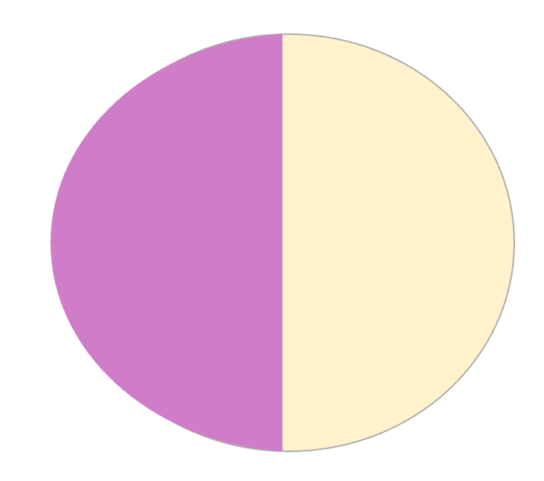

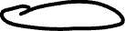

relevant elements
How many retrieved items are relevant?
False Negatives
True Negatives
Precision =
True Positives
False Positives
How many relevant items are retrieved?
Recall =
retrieved elements

Slide 12


Measures the proportion of actual positive cases (cancer present) that were correctly identified
False Negatives
True Negatives
TPR =
True Positives
False Positives
Measures the proportion of actual negative cases (no cancer) that were incorrectly identified as positive.
FPR =
Notes:
XX TPR FPR XX

Slide 13
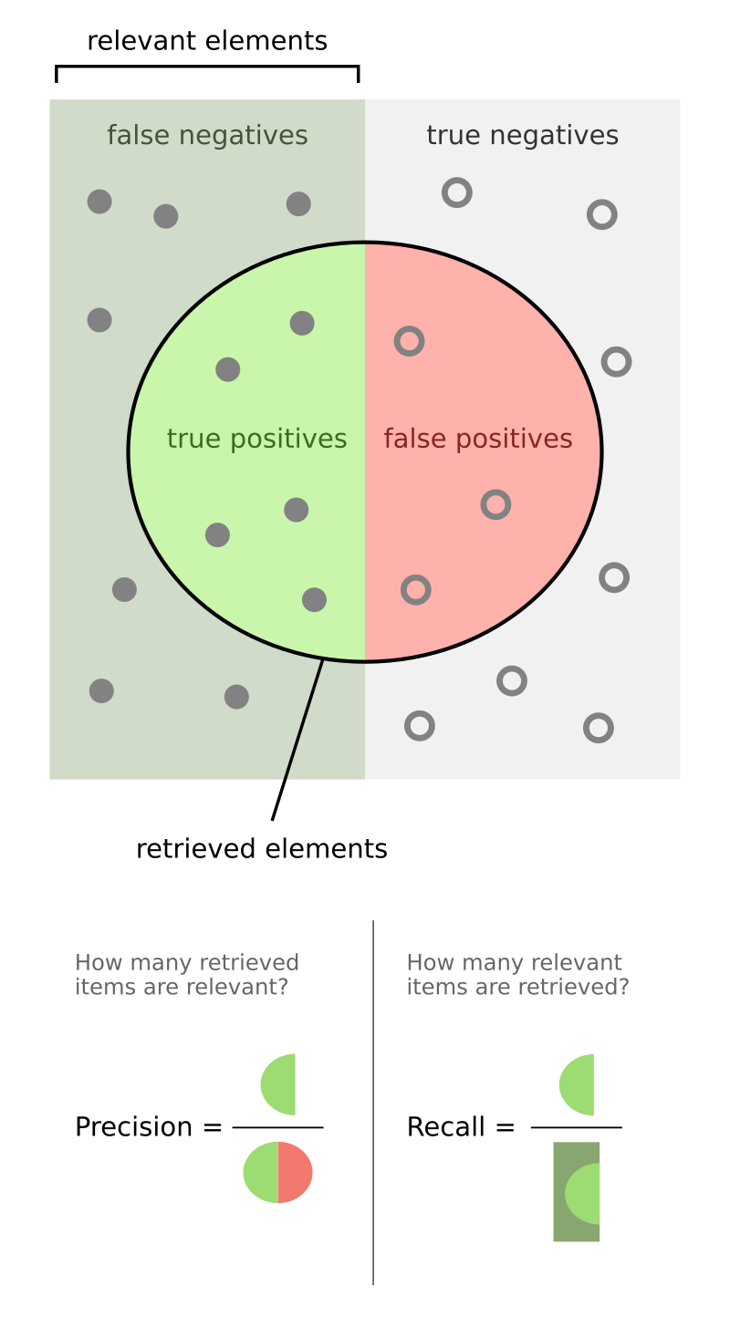

Slide 14
ROC Curve Definition
An ROC curve (receiver operating characteristic curve) is a graph showing the performance of a classification model at all classification thresholds. This curve plots two parameters:
True Positive Rate:
False Positive Rate

Slide 15
Good Model
Output of our Prediction Model
Non-Cancer
Non-Cancer
Non-Cancer
Cancer
Non-Cancer
Cancer
Cancer
Non-Cancer
Cancer
Cancer
N
N
N
N
N
P
P
P
P
P
0.1
0.2
0.3
0.4
0.5
0.6
0.7
0.8
0.9
0.0
1.0
Predicted Risk of Cancer (in probability)

Slide 16
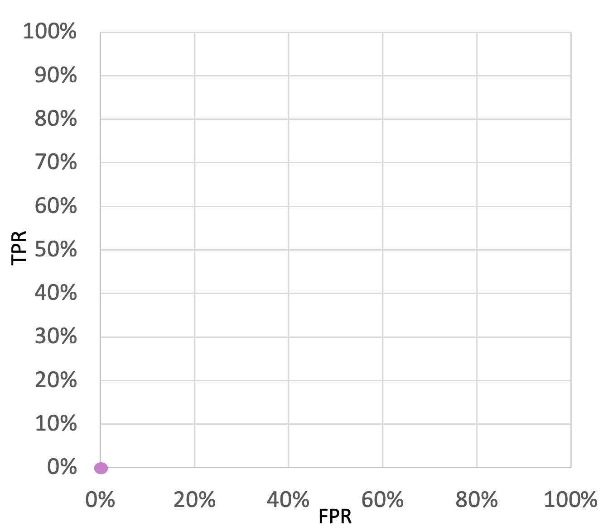
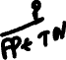
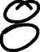
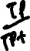
Cancer
Non-Cancer
Non-Cancer
Non-Cancer
Cancer
Non-Cancer
Cancer
Cancer
Non-Cancer
Cancer
Cancer
N
N
N
N
N
N
N
N
N
N
0.1
0.2
0.3
0.4
0.5
0.6
0.7
0.8
0.9
0.0
1.0
Threshold = 1.0
Predicted Risk of Cancer (in probability)
TP=0
Threshold | 1.0 | 0.9 | 0.8 | 0.7 | 0.6 | 0.5 | 0.4 | 0.3 | 0.2 | 0.1 | 0
TPR | 0%
FPR | 0%
ROC Curve
TPR and FPR at 1.0 threshold
FP=0

Slide 17
Cancer
Non-Cancer
Non-Cancer
Non-Cancer
Cancer
Non-Cancer
Cancer
Cancer
Non-Cancer
Cancer
Cancer
N
N
N
N
N
N
N
N
N
P
0.1
0.2
0.3
0.4
0.5
0.6
0.7
0.8
0.9
0.0
1.0
Threshold = 0.9
Predicted Risk of Cancer (in probability)
TP=1
Threshold | 1.0 | 0.9 | 0.8 | 0.7 | 0.6 | 0.5 | 0.4 | 0.3 | 0.2 | 0.1 | 0
TPR | 0% | 20%
FPR | 0% | 0%
ROC Curve
TPR and FPR at 0.9 threshold
FP=0

Slide 18
Non-Cancer
Non-Cancer
Non-Cancer
Cancer
Non-Cancer
Cancer
Cancer
Non-Cancer
Cancer
Cancer
N
N
N
N
N
N
N
N
P
P
0.1
0.2
0.3
0.4
0.5
0.6
0.7
0.8
0.9
0.0
1.0
Threshold = 0.8
Predicted Risk of Cancer (in probability)
TP=2
Threshold | 1.0 | 0.9 | 0.8 | 0.7 | 0.6 | 0.5 | 0.4 | 0.3 | 0.2 | 0.1 | 0
TPR | 0% | 20% | 40%
FPR | 0% | 0% | 0%
TPR and FPR at 0.8 threshold
ROC Curve
FP=0

Slide 19
Non-Cancer
Non-Cancer
Non-Cancer
Cancer
Non-Cancer
Cancer
Cancer
Non-Cancer
Cancer
Cancer
N
N
N
N
N
N
N
P
P
P
0.1
0.2
0.3
0.4
0.5
0.6
0.7
0.8
0.9
0.0
1.0
Threshold = 0.7
Predicted Risk of Cancer (in probability)
TP=2
Threshold | 1.0 | 0.9 | 0.8 | 0.7 | 0.6 | 0.5 | 0.4 | 0.3 | 0.2 | 0.1 | 0
TPR | 0% | 20% | 40% | 40%
FPR | 0% | 0% | 0% | 20%
TPR and FPR at 0.7 threshold
ROC Curve
FP=1

Slide 20
Non-Cancer
Non-Cancer
Non-Cancer
Cancer
Non-Cancer
Cancer
Cancer
Non-Cancer
Cancer
Cancer
N
N
N
N
N
N
P
P
P
P
0.1
0.2
0.3
0.4
0.5
0.6
0.7
0.8
0.9
0.0
1.0
Threshold = 0.6
Predicted Risk of Cancer (in probability)
TP=3
Threshold | 1.0 | 0.9 | 0.8 | 0.7 | 0.6 | 0.5 | 0.4 | 0.3 | 0.2 | 0.1 | 0
TPR | 0% | 20% | 40% | 40% | 60%
FPR | 0% | 0% | 0% | 20% | 20%
TPR and FPR at 0.6 threshold
ROC Curve
FP=1

Slide 21
Non-Cancer
Non-Cancer
Non-Cancer
Cancer
Non-Cancer
Cancer
Cancer
Non-Cancer
Cancer
Cancer
N
N
N
N
N
P
P
P
P
P
0.1
0.2
0.3
0.4
0.5
0.6
0.7
0.8
0.9
0.0
Threshold = 0.5
1.0
Predicted Risk of Cancer (in probability)
TP=4
TPR and FPR at 0.5 threshold
Threshold | 1.0 | 0.9 | 0.8 | 0.7 | 0.6 | 0.5 | 0.4 | 0.3 | 0.2 | 0.1 | 0
TPR | 0% | 20% | 40% | 40% | 60% | 80%
FPR | 0% | 0% | 0% | 20% | 20% | 20%
ROC Curve
FP=1

Slide 22
Non-Cancer
Non-Cancer
Non-Cancer
Cancer
Non-Cancer
Cancer
Cancer
Non-Cancer
Cancer
Cancer
N
N
N
N
P
P
P
P
P
P
0.1
0.2
0.3
0.4
0.5
0.6
0.7
0.8
0.9
0.0
Threshold = 0.4
1.0
Predicted Risk of Cancer (in probability)
TP=4
Threshold | 1.0 | 0.9 | 0.8 | 0.7 | 0.6 | 0.5 | 0.4 | 0.3 | 0.2 | 0.1 | 0
TPR | 0% | 20% | 40% | 40% | 60% | 80% | 80%
FPR | 0% | 0% | 0% | 20% | 20% | 20% | 40%
ROC Curve
TPR and FPR at 0.4 threshold
FP=2

Slide 23
Non-Cancer
Non-Cancer
Non-Cancer
Cancer
Non-Cancer
Cancer
Cancer
Non-Cancer
Cancer
Cancer
N
N
N
P
P
P
P
P
P
P
0.1
0.2
0.3
0.4
0.5
0.6
0.7
0.8
0.9
0.0
Threshold = 0.3
1.0
Predicted Risk of Cancer (in probability)
TP=5
TPR and FPR at 0.3 threshold
Threshold | 1.0 | 0.9 | 0.8 | 0.7 | 0.6 | 0.5 | 0.4 | 0.3 | 0.2 | 0.1 | 0
TPR | 0% | 20% | 40% | 40% | 60% | 80% | 80% | 100%
FPR | 0% | 0% | 0% | 20% | 20% | 20% | 40% | 40%
ROC Curve
FP=2

Slide 24
Non-Cancer
Non-Cancer
Non-Cancer
Cancer
Non-Cancer
Cancer
Cancer
Non-Cancer
Cancer
Cancer
N
N
P
P
P
P
P
P
P
P
0.1
0.2
0.3
0.4
0.5
0.6
0.7
0.8
0.9
0.0
Threshold = 0.2
1.0
Predicted Risk of Cancer (in probability)
TP=5
Threshold | 1.0 | 0.9 | 0.8 | 0.7 | 0.6 | 0.5 | 0.4 | 0.3 | 0.2 | 0.1 | 0
TPR | 0% | 20% | 40% | 40% | 60% | 80% | 80% | 100% | 100%
FPR | 0% | 0% | 0% | 20% | 20% | 20% | 40% | 40% | 60%
TPR and FPR at 0.2 threshold
ROC Curve
FP=3

Slide 25
Non-Cancer
Non-Cancer
Non-Cancer
Cancer
Non-Cancer
Cancer
Cancer
Non-Cancer
Cancer
Cancer
N
P
P
P
P
P
P
P
P
P
0.1
0.2
0.3
0.4
0.5
0.6
0.7
0.8
0.9
0.0
Threshold = 0.1
1.0
Predicted Risk of Cancer (in probability)
TP=5
Threshold | 1.0 | 0.9 | 0.8 | 0.7 | 0.6 | 0.5 | 0.4 | 0.3 | 0.2 | 0.1 | 0
TPR | 0% | 20% | 40% | 60% | 80% | 80% | 100% | 100% | 100% | 100%
FPR | 0% | 0% | 0% | 20% | 20% | 20% | 40% | 40% | 60% | 80%
TPR and FPR at 0.1 threshold
ROC Curve
FP=4

Slide 26
Non-Cancer
Non-Cancer
Non-Cancer
Cancer
Non-Cancer
Cancer
Cancer
Non-Cancer
Cancer
Cancer
P
P
P
P
P
P
P
P
P
P
0.1
0.2
0.3
0.4
0.5
0.6
0.7
0.8
0.9
0.0
1.0
Threshold = 0
Predicted Risk of Cancer (in probability)
TP=5
Threshold | 1.0 | 0.9 | 0.8 | 0.7 | 0.6 | 0.5 | 0.4 | 0.3 | 0.2 | 0.1 | 0
TPR | 0% | 20% | 40% | 60% | 80% | 80% | 100% | 100% | 100% | 100% | 100%
FPR | 0% | 0% | 0% | 20% | 20% | 20% | 40% | 40% | 60% | 80% | 100%
TPR and FPR at 0 threshold
ROC Curve
FP=5

Slide 27
ROC Curve
An ROC curve plots TPR vs. FPR at different classification thresholds. Lowering the classification threshold classifies more items as positive, thus increasing both False Positives and True Positives.
TPR
Threshold | 1.0 | 0.9 | 0.8 | 0.7 | 0.6 | 0.5 | 0.4 | 0.3 | 0.2 | 0.1 | 0
TPR | 0% | 20% | 40% | 40% | 60% | 80% | 80% | 100% | 100% | 100% | 100%
FPR | 0% | 0% | 0% | 20% | 20% | 20% | 40% | 40% | 60% | 80% | 100%
TP vs.FP rate at 0.9 threshold
FPR

Slide 28
Ideal Model
Output of our Prediction Model
Non-Cancer
Non-Cancer
Non-Cancer
Non-Cancer
Non-Cancer
Cancer
Cancer
Cancer
Cancer
Cancer
N
N
N
N
N
P
P
P
P
P
0.1
0.2
0.3
0.4
0.5
0.6
0.7
0.8
0.9
0.0
1.0
Predicted Risk of Cancer (in probability)

Slide 29
Non-Cancer
Non-Cancer
Non-Cancer
Non-Cancer
Non-Cancer
Cancer
Cancer
Cancer
Cancer
Cancer
N
N
N
N
N
N
N
N
N
N
0.1
0.2
0.3
0.4
0.5
0.6
0.7
0.8
0.9
0.0
1.0
Threshold = 1.0
Predicted Risk of Cancer (in probability)
TP=0
Threshold | 1.0 | 0.9 | 0.8 | 0.7 | 0.6 | 0.5 | 0.4 | 0.3 | 0.2 | 0.1 | 0
TPR | 0%
FPR | 0%
ROC Curve
TPR and FPR at 1.0 threshold
FP=0

Slide 30
Non-Cancer
Non-Cancer
Non-Cancer
Non-Cancer
Non-Cancer
Cancer
Cancer
Cancer
Cancer
Cancer
Cancer
N
N
N
N
N
N
N
N
N
P
0.1
0.2
0.3
0.4
0.5
0.6
0.7
0.8
0.9
0.0
1.0
Threshold = 0.9
Predicted Risk of Cancer (in probability)
TP=1
Threshold | 1.0 | 0.9 | 0.8 | 0.7 | 0.6 | 0.5 | 0.4 | 0.3 | 0.2 | 0.1 | 0
TPR | 0% | 20%
FPR | 0% | 0%
ROC Curve
TPR and FPR at 0.9 threshold
FP=0

Slide 31
Non-Cancer
Non-Cancer
Non-Cancer
Non-Cancer
Non-Cancer
Cancer
Cancer
Cancer
Cancer
Cancer
N
N
N
N
N
N
N
N
P
P
0.1
0.2
0.3
0.4
0.5
0.6
0.7
0.8
0.9
0.0
1.0
Threshold = 0.8
Predicted Risk of Cancer (in probability)
TP=2
Threshold | 1.0 | 0.9 | 0.8 | 0.7 | 0.6 | 0.5 | 0.4 | 0.3 | 0.2 | 0.1 | 0
TPR | 0% | 20% | 40%
FPR | 0% | 0% | 0%
TPR and FPR at 0.8 threshold
ROC Curve
FP=0

Slide 32
Non-Cancer
Non-Cancer
Non-Cancer
Non-Cancer
Non-Cancer
Cancer
Cancer
Cancer
Cancer
Cancer
N
N
N
N
N
N
N
P
P
P
0.1
0.2
0.3
0.4
0.5
0.6
0.7
0.8
0.9
0.0
1.0
Threshold = 0.7
Predicted Risk of Cancer (in probability)
TP=3
TPR and FPR at 0.7 threshold
Threshold | 1.0 | 0.9 | 0.8 | 0.7 | 0.6 | 0.5 | 0.4 | 0.3 | 0.2 | 0.1 | 0
TPR | 0% | 20% | 40% | 60%
FPR | 0% | 0% | 0% | 0%
ROC Curve
FP=0

Slide 33
Non-Cancer
Non-Cancer
Non-Cancer
Non-Cancer
Non-Cancer
Cancer
Cancer
Cancer
Cancer
Cancer
N
N
N
N
N
N
P
P
P
P
0.1
0.2
0.3
0.4
0.5
0.6
0.7
0.8
0.9
0.0
1.0
Threshold = 0.6
Predicted Risk of Cancer (in probability)
TP=4
TPR and FPR at 0.6 threshold
Threshold | 1.0 | 0.9 | 0.8 | 0.7 | 0.6 | 0.5 | 0.4 | 0.3 | 0.2 | 0.1 | 0
TPR | 0% | 20% | 40% | 60% | 80%
FPR | 0% | 0% | 0% | 0% | 0%
ROC Curve
FP=0

Slide 34
Non-Cancer
Non-Cancer
Non-Cancer
Non-Cancer
Non-Cancer
Cancer
Cancer
Cancer
Cancer
Cancer
N
N
N
N
N
P
P
P
P
P
0.1
0.2
0.3
0.4
0.5
0.6
0.7
0.8
0.9
0.0
Threshold = 0.5
1.0
Predicted Risk of Cancer (in probability)
TP=5
TPR and FPR at 0.5 threshold
Threshold | 1.0 | 0.9 | 0.8 | 0.7 | 0.6 | 0.5 | 0.4 | 0.3 | 0.2 | 0.1 | 0
TPR | 0% | 20% | 40% | 60% | 80% | 100%
FPR | 0% | 0% | 0% | 0% | 0% | 0%
ROC Curve
FP=0

Slide 35
Non-Cancer
Non-Cancer
Non-Cancer
Non-Cancer
Non-Cancer
Cancer
Cancer
Cancer
Cancer
Cancer
N
N
N
N
P
P
P
P
P
P
0.1
0.2
0.3
0.4
0.5
0.6
0.7
0.8
0.9
0.0
Threshold = 0.4
1.0
Predicted Risk of Cancer (in probability)
TP=5
Threshold | 1.0 | 0.9 | 0.8 | 0.7 | 0.6 | 0.5 | 0.4 | 0.3 | 0.2 | 0.1 | 0
TPR | 0% | 20% | 40% | 60% | 80% | 100% | 100%
FPR | 0% | 0% | 0% | 0% | 0% | 0% | 20%
TPR and FPR at 0.4 threshold
ROC Curve
FP=1

Slide 36
Non-Cancer
Non-Cancer
Non-Cancer
Non-Cancer
Non-Cancer
Cancer
Cancer
Cancer
Cancer
Cancer
N
N
N
P
P
P
P
P
P
P
0.1
0.2
0.3
0.4
0.5
0.6
0.7
0.8
0.9
0.0
Threshold = 0.3
1.0
Predicted Risk of Cancer (in probability)
TP=5
TPR and FPR at 0.3 threshold
Threshold | 1.0 | 0.9 | 0.8 | 0.7 | 0.6 | 0.5 | 0.4 | 0.3 | 0.2 | 0.1 | 0
TPR | 0% | 20% | 40% | 60% | 80% | 100% | 100% | 100%
FPR | 0% | 0% | 0% | 0% | 0% | 0% | 20% | 40%
ROC Curve
FP=2

Slide 37
Non-Cancer
Non-Cancer
Non-Cancer
Non-Cancer
Non-Cancer
Cancer
Cancer
Cancer
Cancer
Cancer
N
N
P
P
P
P
P
P
P
P
0.1
0.2
0.3
0.4
0.5
0.6
0.7
0.8
0.9
0.0
Threshold = 0.2
1.0
Predicted Risk of Cancer (in probability)
TP=5
TPR and FPR at 0.2 threshold
Threshold | 1.0 | 0.9 | 0.8 | 0.7 | 0.6 | 0.5 | 0.4 | 0.3 | 0.2 | 0.1 | 0
TPR | 0% | 20% | 40% | 60% | 80% | 100% | 100% | 100% | 100%
FPR | 0% | 0% | 0% | 0% | 0% | 0% | 20% | 40% | 60%
ROC Curve
FP=3

Slide 38
Non-Cancer
Non-Cancer
Non-Cancer
Non-Cancer
Non-Cancer
Cancer
Cancer
Cancer
Cancer
Cancer
N
P
P
P
P
P
P
P
P
P
0.1
0.2
0.3
0.4
0.5
0.6
0.7
0.8
0.9
0.0
Threshold = 0.1
1.0
Predicted Risk of Cancer (in probability)
TP=5
TPR and FPR at 0.1 threshold
Threshold | 1.0 | 0.9 | 0.8 | 0.7 | 0.6 | 0.5 | 0.4 | 0.3 | 0.2 | 0.1 | 0
TPR | 0% | 20% | 40% | 60% | 80% | 100% | 100% | 100% | 100% | 100%
FPR | 0% | 0% | 0% | 0% | 0% | 0% | 20% | 40% | 60% | 80%
ROC Curve
FP=4

Slide 39
Non-Cancer
Non-Cancer
Non-Cancer
Non-Cancer
Non-Cancer
Cancer
Cancer
Cancer
Cancer
Cancer
P
P
P
P
P
P
P
P
P
P
0.1
0.2
0.3
0.4
0.5
0.6
0.7
0.8
0.9
0.0
1.0
Threshold = 0
Predicted Risk of Cancer (in probability)
TP=5
Threshold | 1.0 | 0.9 | 0.8 | 0.7 | 0.6 | 0.5 | 0.4 | 0.3 | 0.2 | 0.1 | 0
TPR | 0% | 20% | 40% | 60% | 80% | 100% | 100% | 100% | 100% | 100% | 100%
FPR | 0% | 0% | 0% | 0% | 0% | 0% | 20% | 40% | 60% | 80% | 100%
TPR and FPR at 0 threshold
ROC Curve
FP=5

Slide 40
Bad Model
Output of our Prediction Model
Non-Cancer
Cancer
Cancer
Cancer
Cancer
Non-Cancer
Non-Cancer
Non-Cancer
Non-Cancer
Cancer
Non-Cancer
N
N
N
N
N
P
P
P
P
P
0.1
0.2
0.3
0.4
0.5
0.6
0.7
0.8
0.9
0.0
1.0
Predicted Risk of Cancer (in probability)
Notes:
Xx check whether it works XX

Slide 41
Cancer
Non-Cancer
Cancer
Non-Cancer
Non-Cancer
Cancer
Non-Cancer
Non-Cancer
Cancer
Non-Cancer
Cancer
N
N
N
N
N
N
N
N
N
N
0.1
0.2
0.3
0.4
0.5
0.6
0.7
0.8
0.9
0.0
1.0
Threshold = 1.0
Predicted Risk of Cancer (in probability)
TP=0
Threshold | 1.0 | 0.9 | 0.8 | 0.7 | 0.6 | 0.5 | 0.4 | 0.3 | 0.2 | 0.1 | 0
TPR | 0%
FPR | 0%
ROC Curve
TPR and FPR at 1.0 threshold
FP=0

Slide 42
Non-Cancer
Cancer
Non-Cancer
Non-Cancer
Cancer
Cancer
Non-Cancer
Cancer
Non-Cancer
Cancer
Non-Cancer
N
N
N
N
N
N
N
N
N
P
0.1
0.2
0.3
0.4
0.5
0.6
0.7
0.8
0.9
0.0
1.0
Threshold = 0.9
Predicted Risk of Cancer (in probability)
TP=1
Threshold | 1.0 | 0.9 | 0.8 | 0.7 | 0.6 | 0.5 | 0.4 | 0.3 | 0.2 | 0.1 | 0
TPR | 0% | 25%
FPR | 0% | 0%
ROC Curve
TPR and FPR at 0.9 threshold
FP=0

Slide 43
Non-Cancer
Cancer
Non-Cancer
Non-Cancer
Cancer
Cancer
Non-Cancer
Cancer
Non-Cancer
Cancer
Non-Cancer
N
N
N
N
N
N
N
N
P
P
0.1
0.2
0.3
0.4
0.5
0.6
0.7
0.8
0.9
0.0
1.0
Threshold = 0.8
Predicted Risk of Cancer (in probability)
TP=1
Threshold | 1.0 | 0.9 | 0.8 | 0.7 | 0.6 | 0.5 | 0.4 | 0.3 | 0.2 | 0.1 | 0
TPR | 0% | 25% | 25%
FPR | 0% | 0% | 17%
ROC Curve
TPR and FPR at 0.8 threshold
FP=1

Slide 44
Non-Cancer
Cancer
Non-Cancer
Non-Cancer
Cancer
Cancer
Non-Cancer
Cancer
Non-Cancer
Cancer
Non-Cancer
N
N
N
N
N
N
N
P
P
P
0.1
0.2
0.3
0.4
0.5
0.6
0.7
0.8
0.9
0.0
1.0
Threshold = 0.7
Predicted Risk of Cancer (in probability)
TP=2
Threshold | 1.0 | 0.9 | 0.8 | 0.7 | 0.6 | 0.5 | 0.4 | 0.3 | 0.2 | 0.1 | 0
TPR | 0% | 25% | 25% | 50%
FPR | 0% | 0% | 17% | 20%
TPR and FPR at 0.7 threshold
ROC Curve
FP=1

Slide 45
Non-Cancer
Cancer
Non-Cancer
Non-Cancer
Cancer
Cancer
Non-Cancer
Cancer
Non-Cancer
Cancer
Non-Cancer
N
N
N
N
N
N
N
P
P
P
0.1
0.2
0.3
0.4
0.5
0.6
0.7
0.8
0.9
0.0
1.0
Threshold = 0.6
Predicted Risk of Cancer (in probability)
TP=2
Threshold | 1.0 | 0.9 | 0.8 | 0.7 | 0.6 | 0.5 | 0.4 | 0.3 | 0.2 | 0.1 | 0
TPR | 0% | 25% | 25% | 50% | 50%
FPR | 0% | 0% | 17% | 17% | 33%
TPR and FPR at 0.6 threshold
ROC Curve
FP=2

Slide 46
Non-Cancer
Cancer
Non-Cancer
Non-Cancer
Cancer
Cancer
Non-Cancer
Cancer
Non-Cancer
Cancer
Non-Cancer
N
N
N
N
N
P
P
P
P
P
0.1
0.2
0.3
0.4
0.5
0.6
0.7
0.8
0.9
0.0
Threshold = 0.5
1.0
Predicted Risk of Cancer (in probability)
TP=2
Threshold | 1.0 | 0.9 | 0.8 | 0.7 | 0.6 | 0.5 | 0.4 | 0.3 | 0.2 | 0.1 | 0
TPR | 0% | 25% | 25% | 50% | 50% | 50%
FPR | 0% | 0% | 17% | 17% | 33% | 50%
ROC Curve
TPR and FPR at 0.5 threshold
FP=3

Slide 47
Non-Cancer
Cancer
Non-Cancer
Non-Cancer
Cancer
Cancer
Non-Cancer
Cancer
Non-Cancer
Cancer
Non-Cancer
N
N
N
N
P
P
P
P
P
P
0.1
0.2
0.3
0.4
0.5
0.6
0.7
0.8
0.9
0.0
Threshold = 0.4
1.0
Predicted Risk of Cancer (in probability)
TP=3
TPR and FPR at 0.4 threshold
Threshold | 1.0 | 0.9 | 0.8 | 0.7 | 0.6 | 0.5 | 0.4 | 0.3 | 0.2 | 0.1 | 0
TPR | 0% | 25% | 25% | 50% | 50% | 50% | 75%
FPR | 0% | 0% | 17% | 17% | 33% | 50% | 50%
ROC Curve
FP=3

Slide 48
Non-Cancer
Cancer
Non-Cancer
Non-Cancer
Cancer
Cancer
Non-Cancer
Cancer
Non-Cancer
Cancer
Non-Cancer
N
N
N
P
P
P
P
P
P
P
0.1
0.2
0.3
0.4
0.5
0.6
0.7
0.8
0.9
0.0
Threshold = 0.3
1.0
Predicted Risk of Cancer (in probability)
TP=3
TPR and FPR at 0.3 threshold
Threshold | 1.0 | 0.9 | 0.8 | 0.7 | 0.6 | 0.5 | 0.4 | 0.3 | 0.2 | 0.1 | 0
TPR | 0% | 25% | 25% | 50% | 50% | 50% | 75% | 75%
FPR | 0% | 0% | 17% | 17% | 33% | 50% | 50% | 67%
ROC Curve
FP=4

Slide 49
Non-Cancer
Cancer
Non-Cancer
Non-Cancer
Cancer
Cancer
Non-Cancer
Cancer
Non-Cancer
Cancer
Non-Cancer
N
N
P
P
P
P
P
P
P
P
0.1
0.2
0.3
0.4
0.5
0.6
0.7
0.8
0.9
0.0
Threshold = 0.2
1.0
Predicted Risk of Cancer (in probability)
TP=3
Threshold | 1.0 | 0.9 | 0.8 | 0.7 | 0.6 | 0.5 | 0.4 | 0.3 | 0.2 | 0.1 | 0
TPR | 0% | 25% | 25% | 50% | 50% | 50% | 75% | 75% | 75%
FPR | 0% | 0% | 17% | 17% | 33% | 50% | 50% | 67% | 83%
ROC Curve
TPR and FPR at 0.2 threshold
FP=5

Slide 50
Non-Cancer
Cancer
Non-Cancer
Non-Cancer
Cancer
Cancer
Non-Cancer
Cancer
Non-Cancer
Cancer
Non-Cancer
N
N
P
P
P
P
P
P
P
P
0.1
0.2
0.3
0.4
0.5
0.6
0.7
0.8
0.9
0.0
Threshold = 0.1
1.0
Predicted Risk of Cancer (in probability)
TP=4
TPR and FPR at 0.1 threshold
Threshold | 1.0 | 0.9 | 0.8 | 0.7 | 0.6 | 0.5 | 0.4 | 0.3 | 0.2 | 0.1 | 0
TPR | 0% | 25% | 25% | 50% | 50% | 50% | 75% | 75% | 75% | 100%
FPR | 0% | 0% | 17% | 17% | 33% | 50% | 50% | 67% | 83% | 83%
ROC Curve
FP=6

Slide 51
Non-Cancer
Cancer
Non-Cancer
Cancer
Non-Cancer
Cancer
Non-Cancer
Cancer
Non-Cancer
Cancer
P
P
P
P
P
P
P
P
P
P
0.1
0.2
0.3
0.4
0.5
0.6
0.7
0.8
0.9
0.0
1.0
Threshold = 0
Predicted Risk of Cancer (in probability)
TP=4
Threshold | 1.0 | 0.9 | 0.8 | 0.7 | 0.6 | 0.5 | 0.4 | 0.3 | 0.2 | 0.1 | 0
TPR | 0% | 25% | 25% | 50% | 50% | 50% | 75% | 75% | 75% | 100% | 100%
FPR | 0% | 0% | 17% | 17% | 33% | 50% | 50% | 67% | 83% | 83% | 100%
TPR and FPR at 0 threshold
ROC Curve
FP=6

Slide 52
AUC is desirable for the following two reasons:
AUC is scale-invariant. It measures how well predictions are ranked, rather than their absolute values.
AUC is classification-threshold-invariant. It measures the quality of the model's predictions irrespective of what classification threshold is chosen.

Slide 53
AUC stands for "Area under the ROC Curve." That is, AUC measures the entire two-dimensional area underneath the entire ROC curve (think integral calculus) from (0,0) to (1,1).
Good Model
Ideal Model
Bad Model
TPR
84%
TPR
100%
TPR
60%
62.5%
FPR
FPR

Slide 54
Application: Breast Cancer Risk Prediction
Gordon Gao
Carey Business School Professor

Slide 55
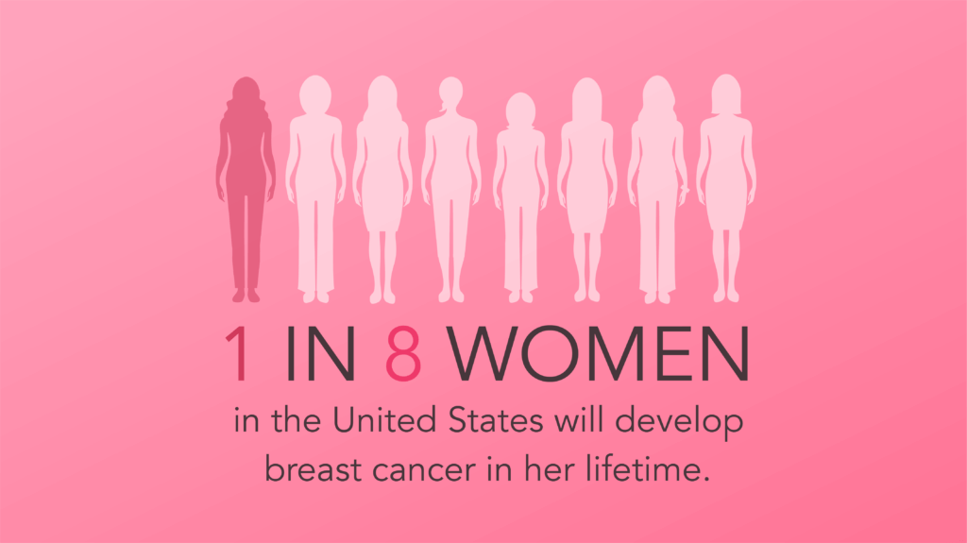

Slide 56
Every 2 minutes a woman is diagnosed with breast cancer in the United States.
In 2024, approximately 30% of all new female cancer diagnoses will be breast cancer.
Source:

Slide 57
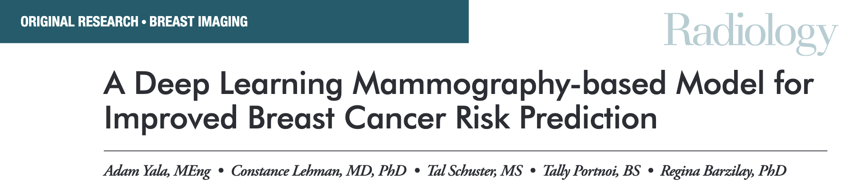
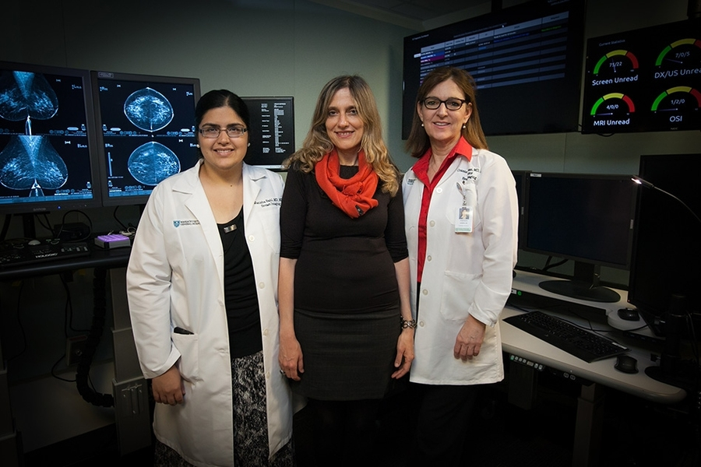
https://pubs.rsna.org/doi/epdf/10.1148/radiol.2019182716

Slide 58
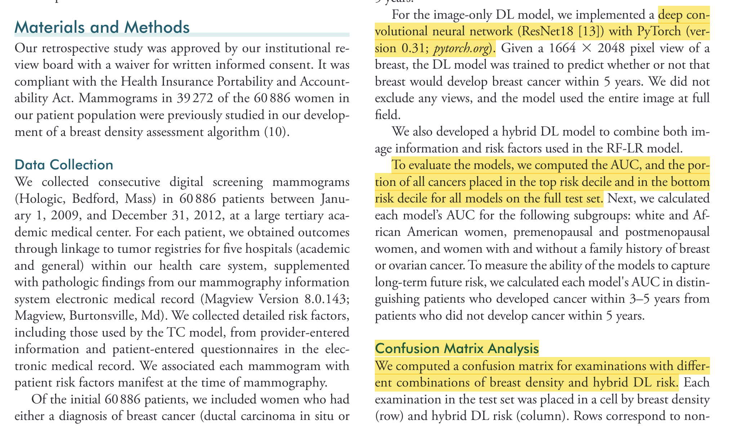
Radiology 2019; 292:60–66﻿ • https://doi.org/10.1148/radiol.2019182716

Slide 59
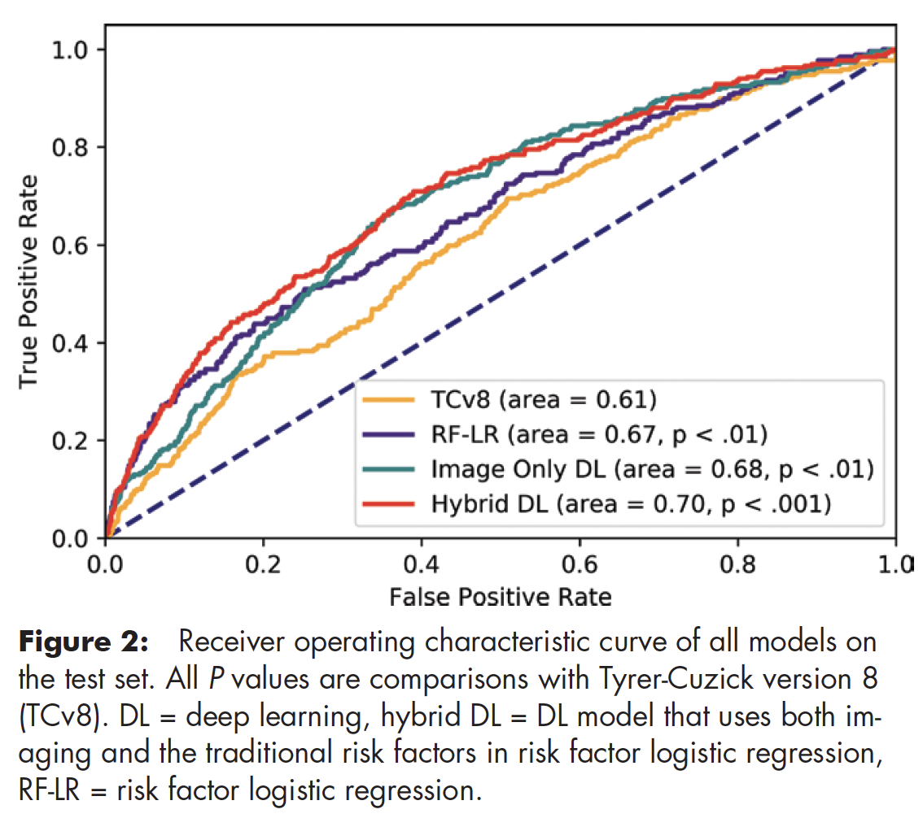
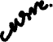
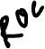

Slide 60
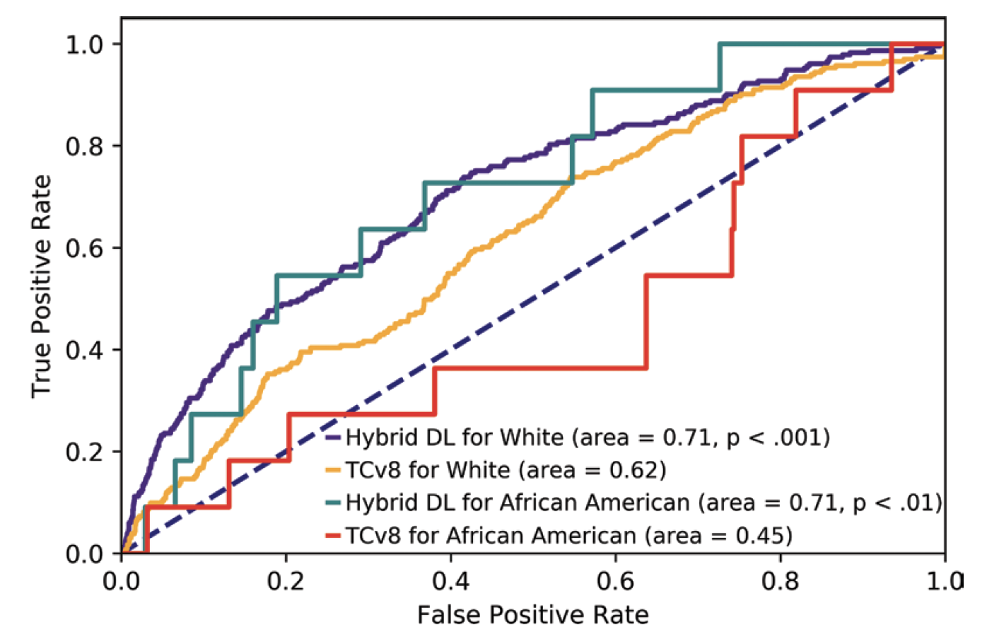

Slide 61

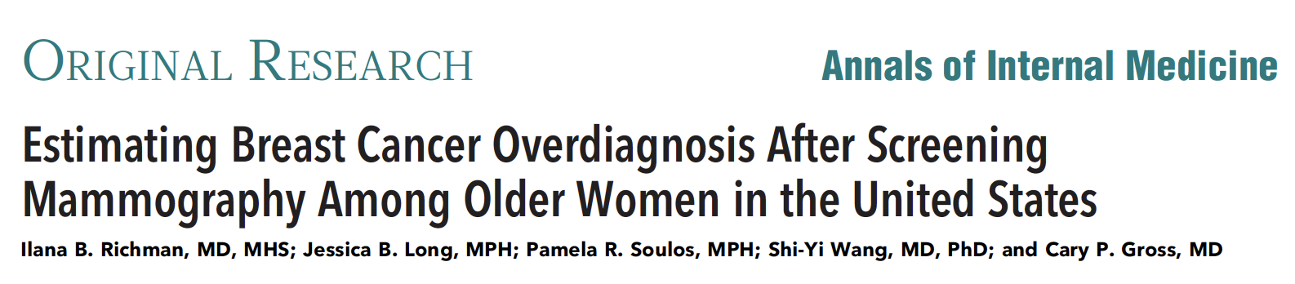
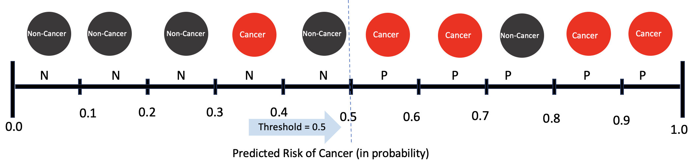
85 years and older: 54% of breast cancer may be overdiagnosed.
Up to 90% of women aged 80 years and older with nonmetastatic breast cancer undergo surgery
Where should you draw the line?
balance true positive and false positive

